Slide 1

Mini Project (KCA-353)
Odd Semester
Session 2024-25
BoloBuzz(GB12)
MENTEE
MENTOR
Shivam Pal: 2300290140168
Sandeep Sahu:2300290140158
Shivam Pandey: 2300290140169
Ayaz Hasan:2300290140180
Ms. Annu Yadav
(Assistant Professor)

Slide 2


Bolobuzz : The Team Collaboration Platform
BoloBuzz
Bolobuzz is an innovative web application designed for seamless team communication and collaboration. It mimics real-time messaging functionalities, channel-based discussions, and file-sharing capabilities, tailored to streamline team workflows.

Slide 3

Core Features
Real-time Messaging
Channel Creation

Slide 4

Real-time Messaging
Instant communication within public channels and private messages, powered by robust real-time technology to ensure immediate message delivery and updates.

Slide 5

Channel Creation
Ability to create and manage dedicated channels for specific topics, departments, or projects, promoting organized and focused discussions.

Slide 6
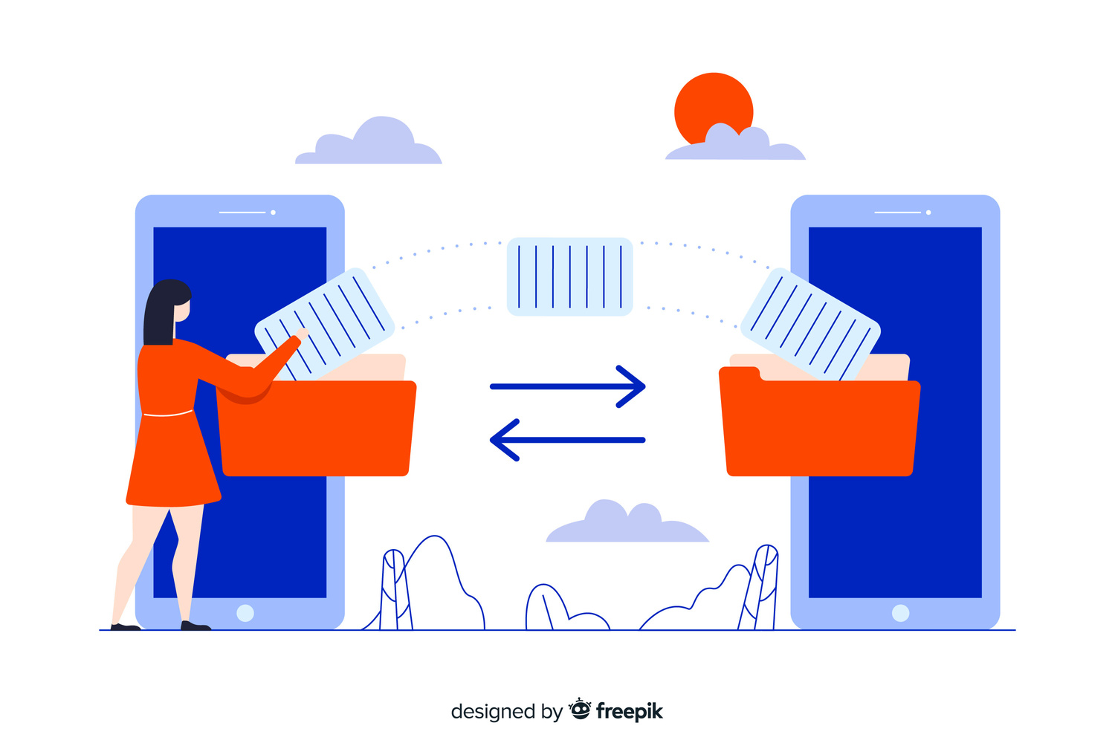
File Sharing and Management
File Uploads
Users can share files such as documents, images, and PDFs within channels or private chats.
File Management
Intuitive interface for viewing, downloading, and managing shared files, making collaboration efficient and effective.

Slide 7

User Authentication and Security
Secure Login/Registration
Users can share files such as documents, images, and PDFs within channels or private chats.
Privacy Settings
User-controlled privacy options to manage visibility within channels and direct messages.

Slide 8

Search and Navigation
User-Friendly Interface
Advanced Search
Comprehensive search tool allowing users to find specific messages, files, or conversation threads easily
Comprehensive search tool allowing users to find specific messages, files, or conversation threads easily

Slide 9

Technology Stack
Frontend: Built using modern technologies like React for dynamic and responsive UI.
Backend: Powered by Node.js and Express.js for efficient server-side operations.
Database: MongoDB for robust data storage and retrieval.
Real-time Communication: Implemented using WebSocket or libraries like Socket.io for real-time updates.
Security: Features JWT for secure token-based authentication.

Slide 10

Modules
User Authentication
Channel Management
Messaging System
User Interface

Slide 11


Workflow
1.User Login
2.Workspace &
Channel Navigation
3.Messaging
4.File Sharing &
Notifications

Slide 12

Future Enhancements
Upcoming Features:
Plans to include video conferencing, more extensive integration with third-party tools (e.g., Google Drive, Trello), and advanced notification settings.
Feedback Mechanism
User feedback collection to guide continuous improvements and feature enhancements.

Slide 13

Demo and Conclusion
Snapshots
Showcase the functionality of Bolobuzz in action

Slide 14
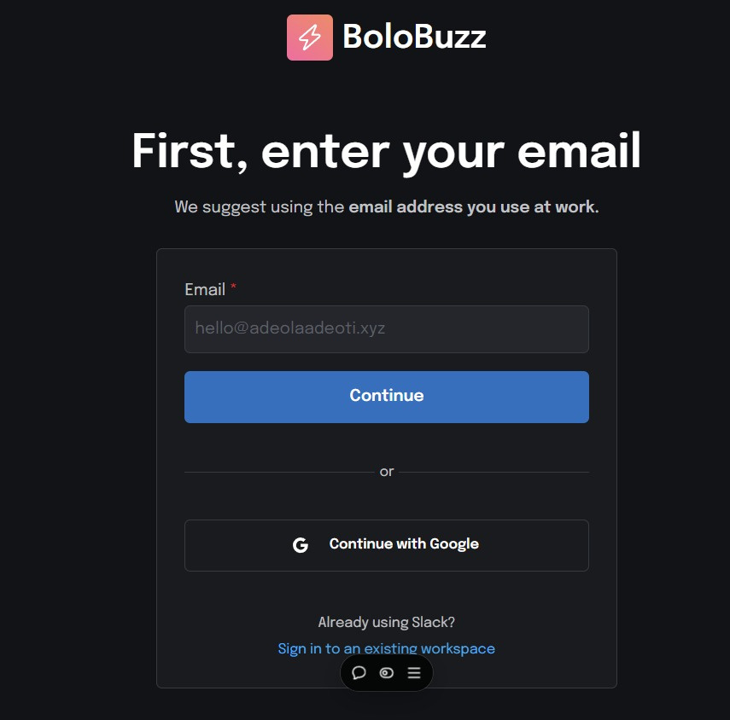
Register/Sign/SigUp

Slide 15
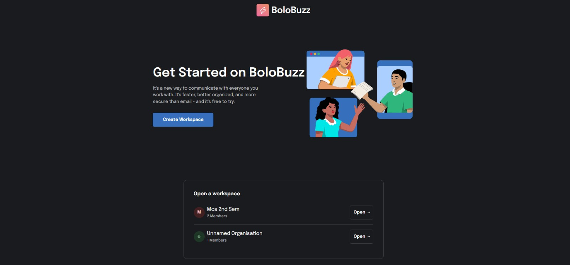
Homepage

Slide 16
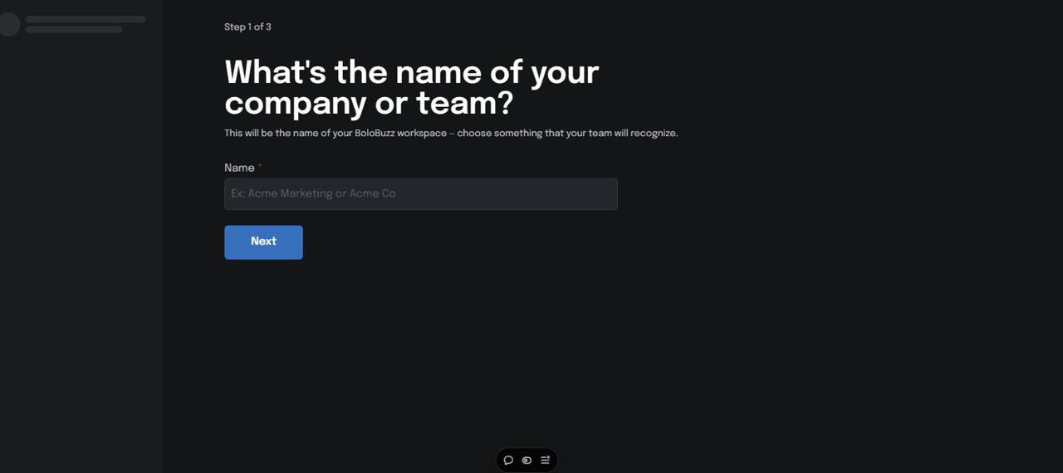
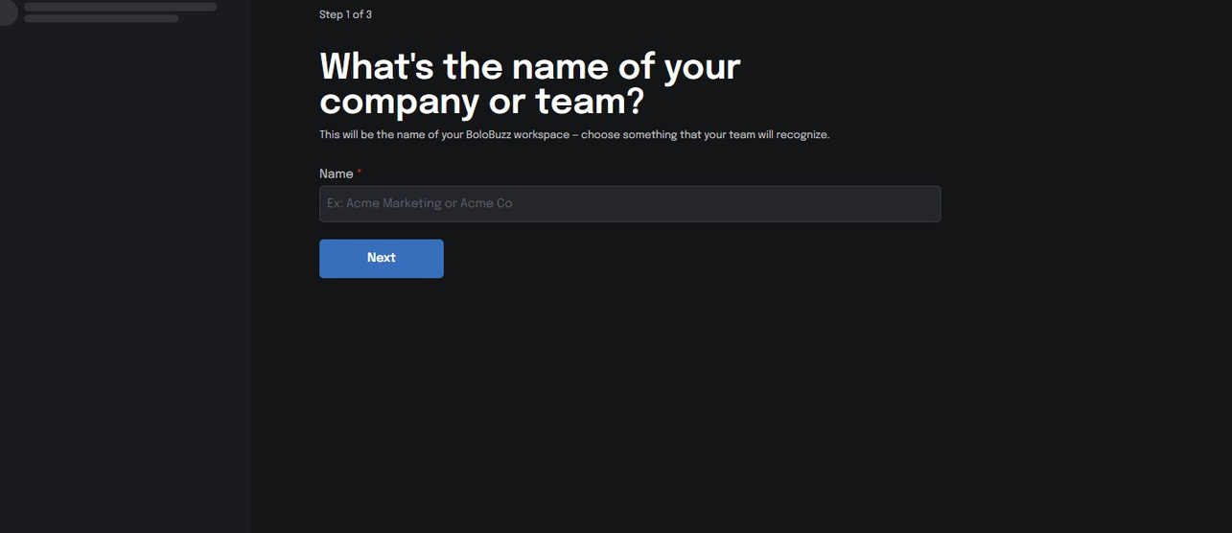
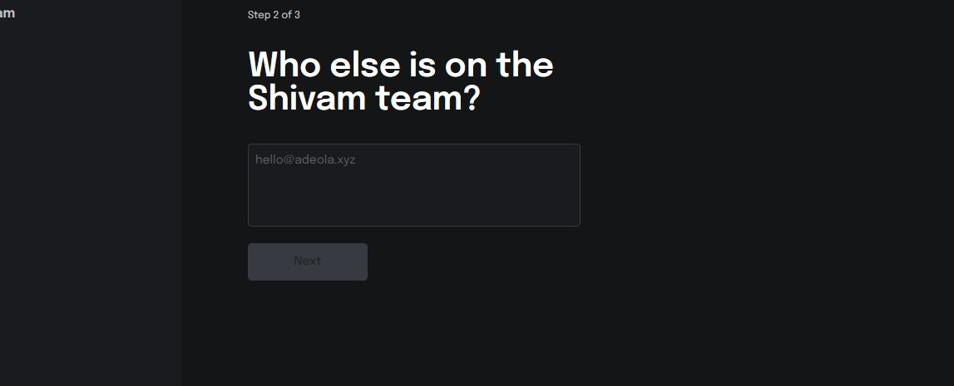
Channel Creations

Slide 17
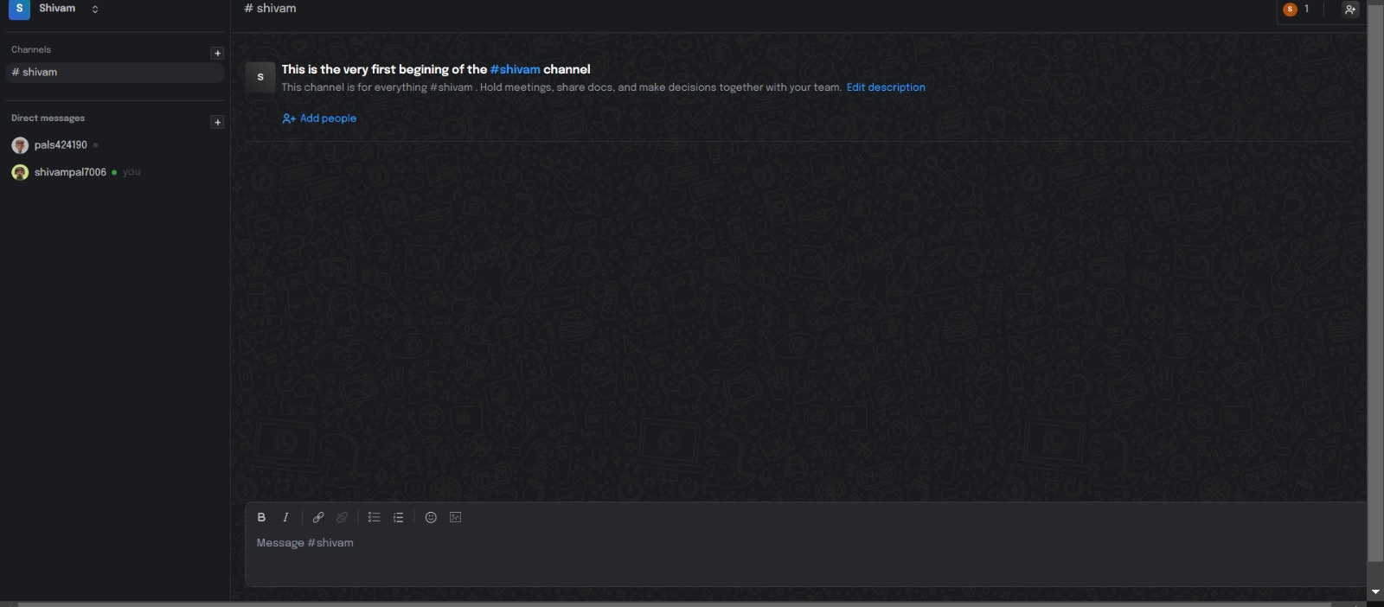
Messaging Section & File Sharing

Slide 18


